Slide 1
《Health and Fitness》
———主讲人：刘劼昊
2022 年 11月

Slide 3
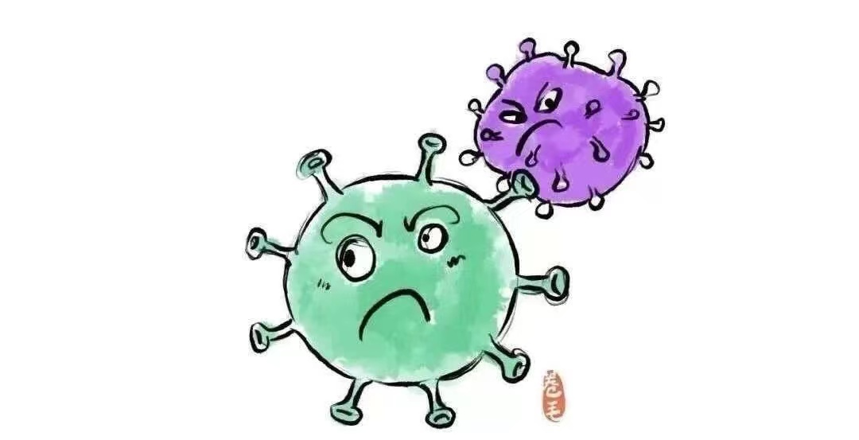
Think and discuss
What happened
in 2019 ?

Slide 4
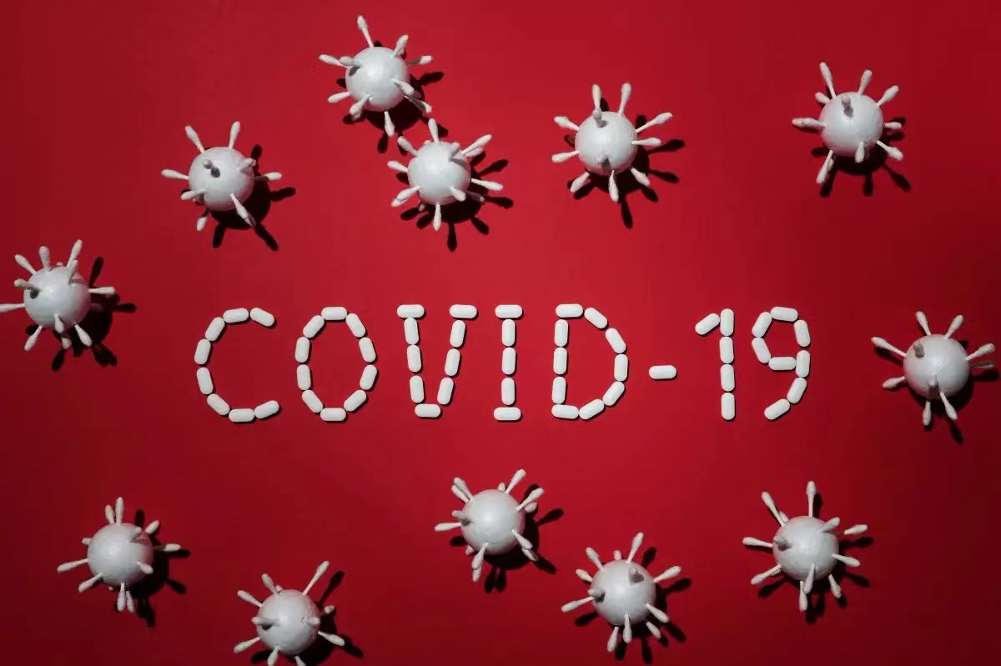
COVID-19: 新型冠状病毒肺炎
CO: 冠状物(corona) /kə΄rᴏʊnə/
VI: 病毒（virus）/΄vaɪrəs/
D: 疾病（disease）/dɪ΄ziːz/

Slide 5
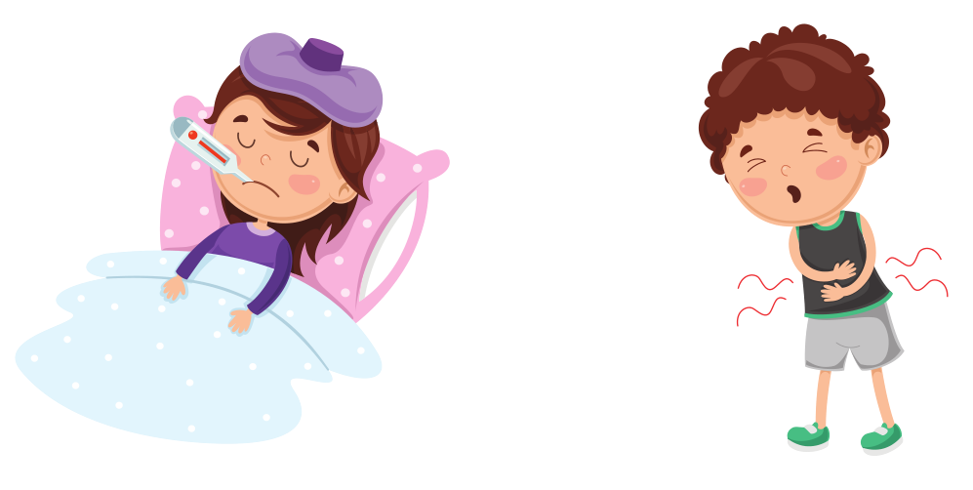
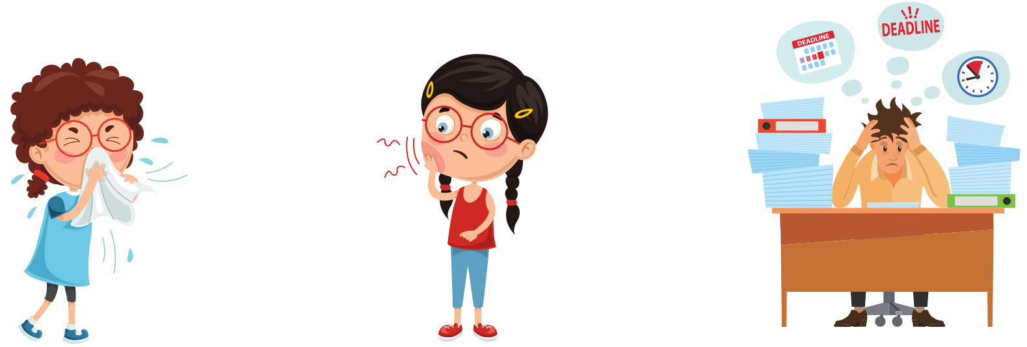
fever/΄fiː vər/: 发烧
stomachache/΄stʌməkeɪk/: 胃疼
allergy: 过敏
toothache: 牙痛
under pressure:在压力下

Slide 6
02
Listening and Speaking

Slide 7
Listen, read and underline.
Jack, a German technician working in Shanghai, doesn’t feel well and goes to see a doctor.
Jack: Good morning, Sir. Here is my appointment number.
Doctor: Thank you. So, what’s wrong with you?
Jack: I have a sore throat and a terrible cough, and my temperature is over 39°C.
Doctor: I see. How long have you been like this?
Jack: Since yesterday evening.
Doctor: Please open your mouth and say “Ah”. Hmmm, I’m afraid you have a bad cold.
Jack: Is there anything I can do about it? I feel really bad.
Doctor: Yes, there is. Take this medicine one tablet three times a day, drink more water and do have a good rest.
Jack: What else should I pay attention to?
Doctor: You should avoid heavy food. And when you are feeling better, do more exercise.
Jack: Thank you. When can I recover from it?
Doctor: Well, it will take about one week.

Slide 8
What’s wrong with you?
I have……
How long have you been like this?
Since…… Is there anything I can do about it? I feel really bad.
You should……

Slide 9
Role-play
两人一组，进行角色扮演，同学A扮演双语国际幼儿园的幼师，同学B扮演幼儿园的学生，现同学B处出现了一些健康问题，作为双语幼师的你该如何给小朋友提出合理化的建议呢？

Slide 10
Think and match.
• allergy
• fever
• under pressure
• toothache
• stomachache
1
fever
2
stomachache
allergy
4
。toothache
under pressure
3
5

Slide 11
What’s wrong with you?
I have……
• allergy：过敏
• fever：发烧
• under pressure：在压力下
• toothache：牙疼
• stomachache：胃疼
How long have you been like this?
Since…… Is there anything I can do about it? I feel really bad.
You should……

Slide 12
Think and discuss.
思考并讨论运动给身心带来的益处。
be stronger
feel happier
be more confident
be more energetic

Slide 13
It’s important to take care of yourself in this life.Except for your health, nothing is yours.
(人这一生重要的是照顾好自己，除了你的健康，什么都不属于你。）

